Slide 1

GRAPH THEORY AND ITS APPLICATIONS
Dr. Arti arya
Department of Computer Science & Engineering

Slide 2
GRAPH THEORY AND ITS APPLICATIONS
INTRODUCTION
Dr. Arti Arya
Department of Computer Science & Engineering

Slide 3

Graph Theory and its Applications Disclaimer
The slides are prepared by Dr. Surabhi Narayan and a lot of inputs are added by Dr. Arti Arya. The sources of the information other than text book is mentioned wherever used.

Slide 4
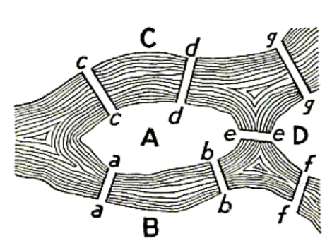
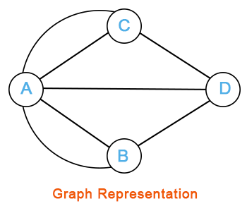

Graph Theory and its Applications
History
The Konigsberg Bridge Problem
Whether one could leave home cross every bridge exactly once and return home

Slide 5
Graph Theory and its Applications
Basic Definition
What is a Graph?
G=(V,E)
V= nodes ( or vertices)
E= Edges or arcs between pair of nodes
Captures pairwise relationship between objects.
Order of Graph G is the no. of vertices in G ie., n(G)=|V|
Size of Graph G is the no. of edges in G ie., e(G)=|E|

Slide 6
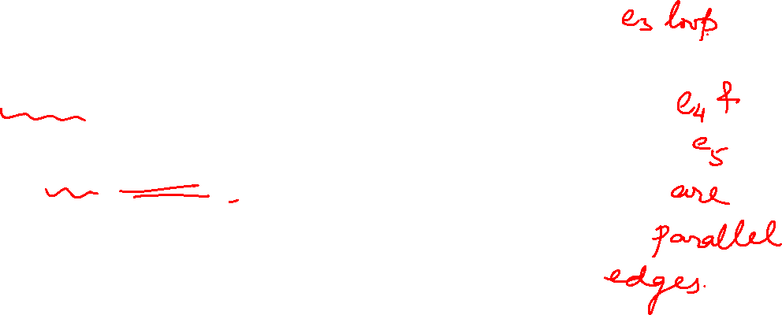
Graph Theory and its Applications Graph Basics
Edges that have the same end vertices are parallel.
Edge of the form (v,v) is a loop.
Simple Graph: A graph that is undirected and does not have any loops or multiple edges.
Trivial graph: A trivial graph is a graph with only one vertex and no edges. It is also known as a singleton graph or a single vertex graph
e₃
V₁
V₅
e₁
e₄
e₂
e₅
V₂
V₃
V₄

Slide 7

Graph Theory and its Applications
Null and Empty Graph
A null graph is one where the node set is empty (there are no nodes)
Since there are no nodes, there are also no edges
G(V, E), V = E = ∅ ( order zero graph)
(https://link.springer.com/chapter/10.1007/BFb0066433
(Is Null graph a pointless concept?
Very interesting conclusion mentioned:
No conclusion has been reached. )
Note: In your textbook the Author Narsingh Deo is considering Empty graph as Null graph but in Footnote he mentions a NULL Graph the way we have defined.

Slide 8


NETWORK ANALYSIS AND MINING
Empty Graph
An empty graph or edge-less graph is one where the edge set is empty, E = ∅
The node set can be non-empty.
A null-graph is an empty graph.
An empty graph need not be a null graph.

Slide 9

Graph Theory and its Applications Graph Basics
Adjacent Edges: Adjacent edges are edges that share a common vertex.
e₃
Adjacent Vertices: If two vertices in a graph are connected by an edge, we say the vertices are adjacent
Degree of a vertex: the no. of edges connecting it
V₁
V
5
e
1
e₄
e₂
e₅
V
V
V₄
2
3

Slide 10
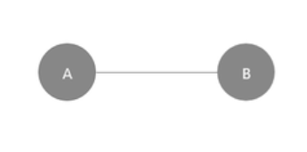
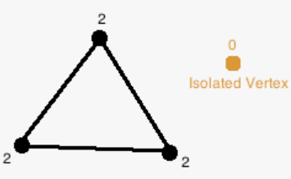
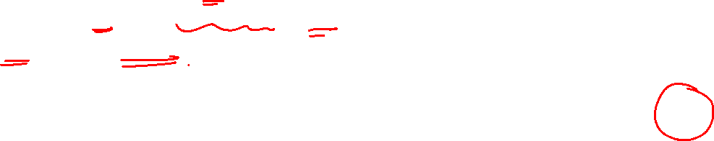
Graph Theory and its Applications Graph Basics
Pendant Vertex: pendant vertices are the vertices that have degree 1
Pendant Edge: An edge of a graph is said to be a pendant edge if and only if one of its vertices is a pendant vertex.
Isolated Vertex:
The vertex 'a' and vertex 'b' has a no connectivity between each other and also to any other vertices.

Slide 11
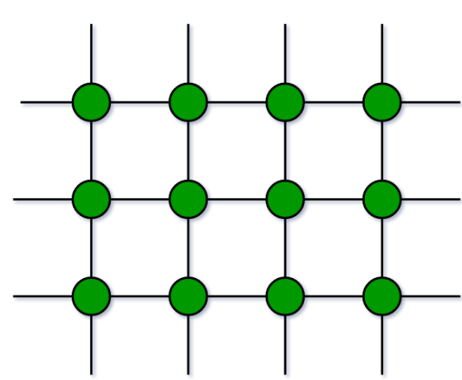
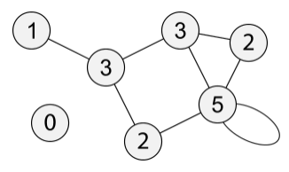
Graph Theory and its Applications Graph Basics
Minimum degree of Graph G: 𝛿(G): minimum of its vertices' degrees
Maximum degree of Graph G: Δ(G): the maximum of its vertices' degrees.
Finite Graph: A graph in which the vertex set and the edge set are finite sets
Infinite Graph: A graph in which the vertex set and the edge set are infinite sets
e₃
V₁
V₅
e₁
e₄
e₂
e₅
V₂
V₃
V₄

Slide 12
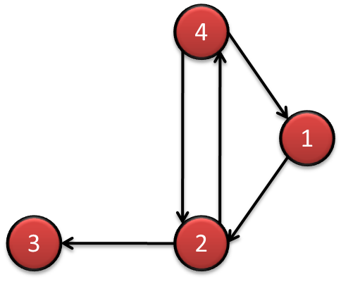
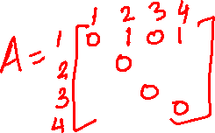
Graph Theory and its Applications
Directed and Undirected Graphs
The adjacency matrix for directed graphs is not symmetric (A ≠ A^{T})
(A_{ij} ≠ A_{ji})
The adjacency matrix for undirected graphs is symmetric (A = A^{T})
4
1
3
2

Slide 13

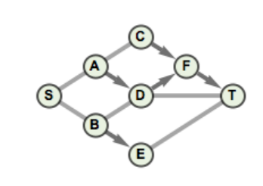
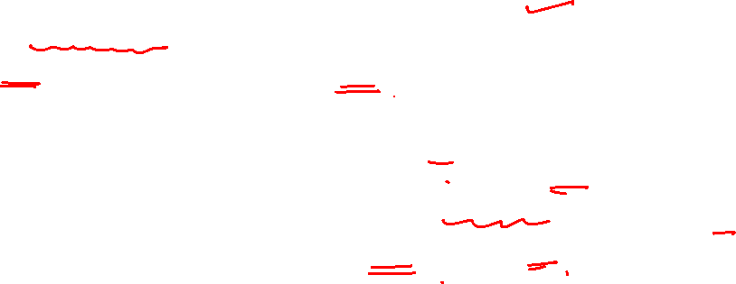
Graph Theory and its Applications
Mixed Graphs
Both directed and undirected edges are present.
a mixed graph G = (V, E, A) is a graph consisting of a set of vertices V, a set of (undirected) edges E, and a set of directed edges (or arcs) A.
Or Say in social media, two persons are connected to each other but not following one another( undirected edge) and another set of nodes having directed edge( say C is following F)
Mixed graphs can be used to model a schedule that has both incompatibility, represented by undirected edges, and precedence constraints, represented by directed edges.

Slide 14
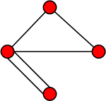
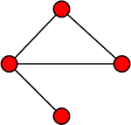
Graph Theory and its Applications
Simple and Multigraphs
Simple graphs are graphs where only a single edge can be there between any pair of nodes
Multi-graphs are graphs where you can have multiple edges between two nodes and loops.
The adjacency matrix for undirected multigraphs can include numbers larger than one ( when 1 means presence of edge), indicating multiple edges between nodes
Multigraph
Simple graph

Slide 15
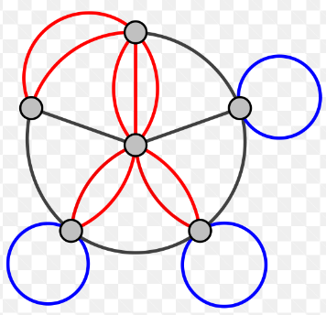
Graph Theory and its Applications
What can lead to Multigraph ?
Multi Graphs can be seen in social media where there can be different types of relations between two nodes like being friends as well as colleagues or relatives.
A multigraph is different from a hypergraph, which is a graph in which an edge can connect any number of nodes, not just two.

Slide 16
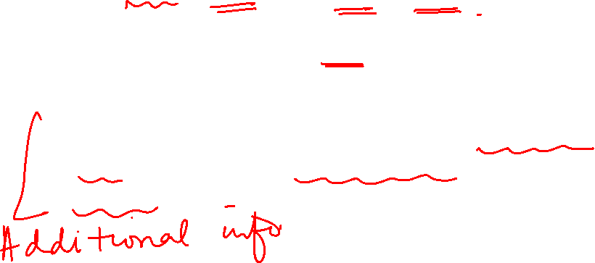
Graph Theory and its Applications
Other types of Graph
Hypergraph : Essentially a generalization of undirected graphs in which edges are subsets of two or more vertices.
While graph edges connect only 2 nodes, hyperedges connect an arbitrary number of nodes.
The size of the vertex set is called the order of the hypergraph, and the size of edges set is the size of the hypergraph.

Slide 17
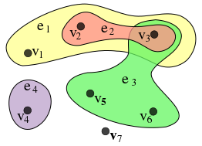
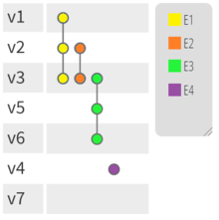
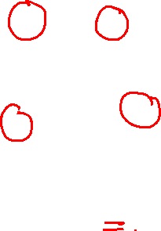
Graph Theory and its Applications
Examples of hypergraph from Wikipedia
Undirected hypergraph G = (V,E) i.e. with
V= { v1,v2,v3,v4,v5,v6,v7 } and
E = { e1,e2,e3,e4} = { { v1,v2,v3}, {v2,v3}, { v3,v5,v6}, {v4}}.
This hypergraph has order 7 and size 4 ( no of hyperedges)

Slide 18


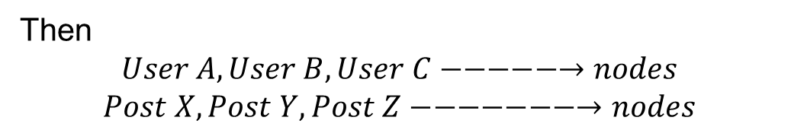
Graph Theory and its Applications
Instead of representing these interactions using a traditional graph where each user is connected to a post, a hypergraph can be used to capture more complex interactions involving multiple users and posts simultaneously.
Examples of hypergraph from Wikipedia
Social Media Interactions:
Say you have a social media platform with users and posts. Each user can like, comment on, and share multiple posts.
Then
$$User A, User B, User C−−−−−→nodes$$
$$Post X, Post Y, Post Z−−−−−−−→nodes$$
A hyperedge connects Users and Posts and thus represent interaction between them.
Say hyperedge e1: ( A, X, Y) to represent that User A liked Post X and commented on Post Y.
e2: ( A, B, C, X, Y) to represent User A, B and C liked Post X and commented on Post Y

Slide 19
Graph Theory and its Applications
Examples of hypergraph from Wikipedia
Consider a group of people attending different events:
Vertices (V): {Alice, Bob, Carol, David, Events A, B, C}
Hyperedges (E):
Hyperedge 1: {Alice, Bob} (Alice and Bob attended an event together)
Hyperedge 2: {Carol, David} (Carol and David attended an event together)
Hyperedge 3: {Alice, Event A} (Alice attended Event A)
Hyperedge 4: {Bob, Event B} (Bob attended Event B)
Hyperedge 5: {David, Event C} (David attended Event C)
In this example, hyperedges can connect both individuals and events, reflecting various types of relationships.
Hypergraph theory explores properties, algorithms, and structures related to hypergraphs. The concepts of hypergraph connectivity, matching, coloring, and clustering have analogs to traditional graph theory but apply to the more general context of hypergraphs.

Slide 20
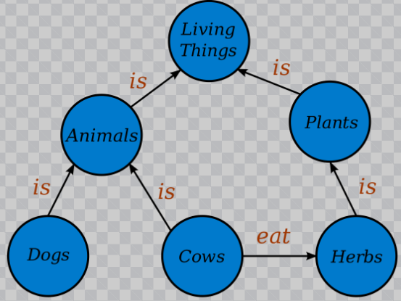
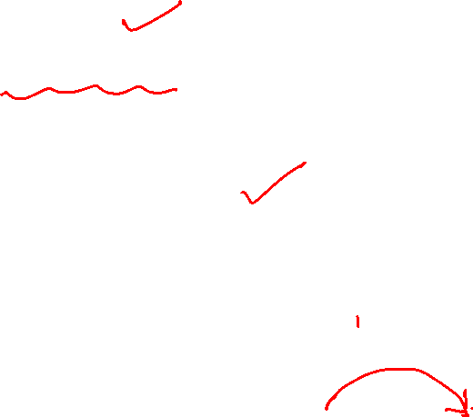
Graph Theory and its Applications
Other types of Graph
Knowledge graph: Directed multi-relational graph where an edge represents a tuple <h,r,t> i.e. head, relation and tail.
There can be multiple relations between two entities. Example – <Star Trek, Genre, Science Fiction>
Knowledge graph is a knowledgebase that uses a graph-structured data model or topology to integrate data.
It formally represents semantics by describing entities and their relationships.
They are also prominently associated with and used by search engines such as Google, Bing etc.

Slide 21





Graph Theory and its Applications Graph Basics
Complete graph: K_{n}, is the simple graph that contains exactly one edge between each pair of distinct vertices.
Representation Example: K₁, K₂, K₃, K₄
K₁
K₂
K₃
K₄

Slide 22

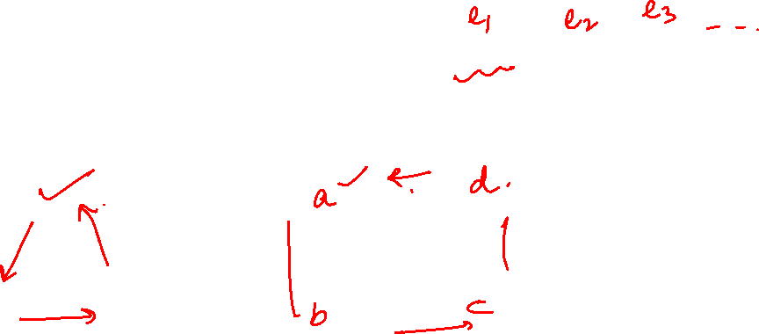
Graph Theory and its Applications Graph Basics
Cycle: C_{n},
n ≥ 3 consists of n vertices v₁, v₂, v₃ … v_{n} and edges {v₁, v₂}, {v₂, v₃}, {v₃, v₄} … {v_{n-1}, v_{n}}, {v_{n}, v₁}
Representation Example: C₃, C₄
C₃
C₄

Slide 23

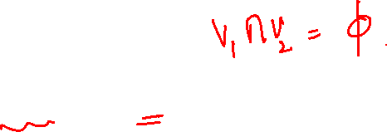
Graph Theory and its Applications Graph Basics
Bipartite graphs
Partition into disjoint sets V1 and V2
Application example: Representing Relations
Representation example: V₁ = {v₁, v₂, v₃} and V₂ = {v₄, v₅, v₆},
v₁
v₄
v₂
v₅
v₃
v₆
V₁
V₂

Slide 24
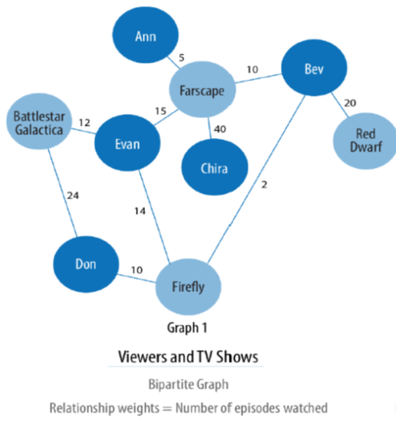
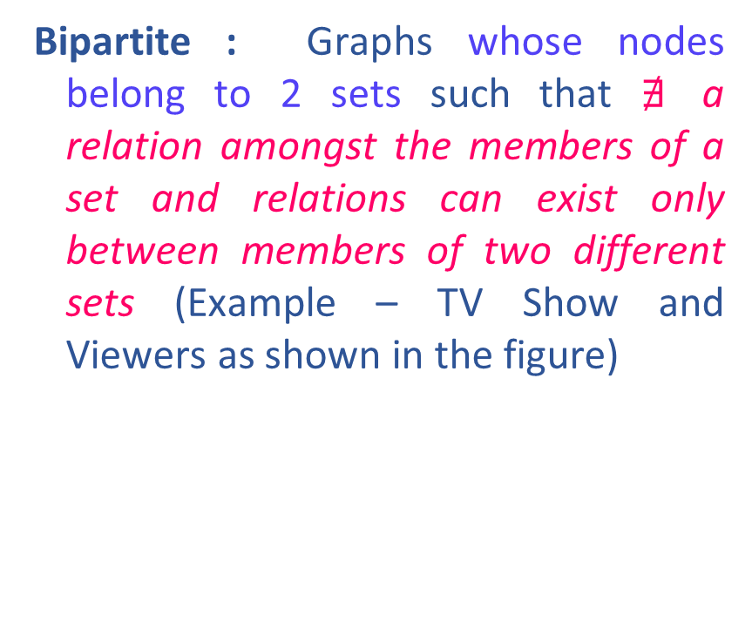
Graph Theory and its Applications
Monopartite and Bipartite Graphs
Bipartite : Graphs whose nodes belong to 2 sets such that $∄$ a relation amongst the members of a set and relations can exist only between members of two different sets (Example – TV Show and Viewers as shown in the figure)

Slide 25
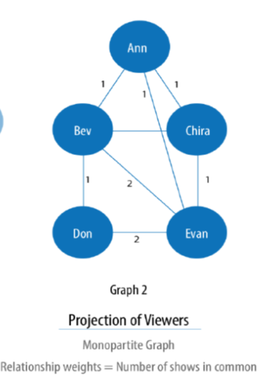

Graph Theory and its Applications
Monopartite and Bipartite Graphs
Monopartite : Graphs with only one node type and one relation type.
Bipartite graph can be projected into monopartite graphs with inferred connections.
K-partite : Number of node types is K

Slide 26
Graph Theory and its Applications
Projection of bipartite graph based on inferred relation

Slide 27
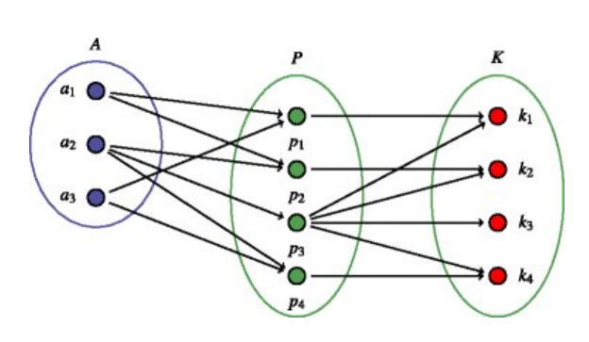
Graph Theory and its Applications
Tripartite Examples
An example of a tripartite graph with Authors (A), Publications (P) and Keywords (K)

Slide 28


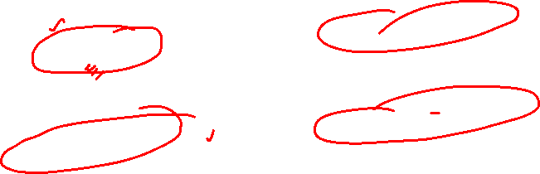
Graph Theory and its Applications Graph Basics
Complete Bipartite graphs
K_{m,n} is the graph that has its vertex set portioned into two subsets of m and n vertices, respectively.
There is an edge between two vertices if and only if one vertex is in the first subset and the other vertex is in the second subset.
Representation example: K_{2,3,} K_{3,3}
^{K}2,3
^{K}3,3

Slide 29

Graph Theory and its Applications Graph Basics
Chromatic Number
The minimum number of colors needed to label the vertices such that adjacent vertices are colored with different colors.
Eg: Scheduling meetings of committees

Slide 30







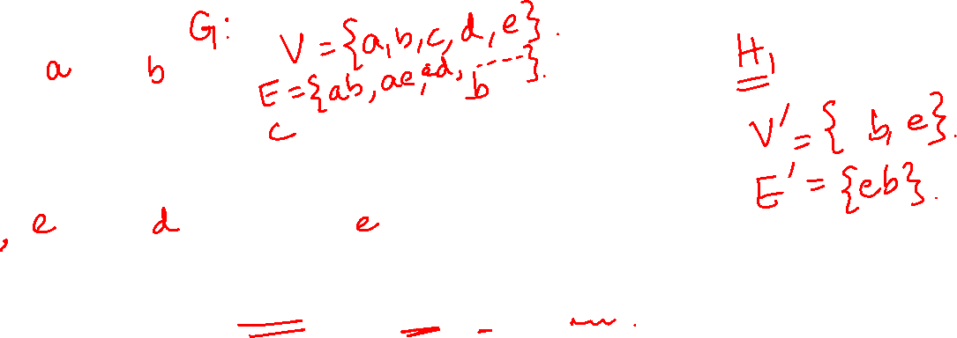
Graph Theory and its Applications Graph Basics
Subgraph
A subgraph of a graph G is a graph H such that V(H)⊆ V(G) and E(H) ⊆ E(G).
Assignment of endpoints to edges in H is same as G
G
H1
H2

Slide 31
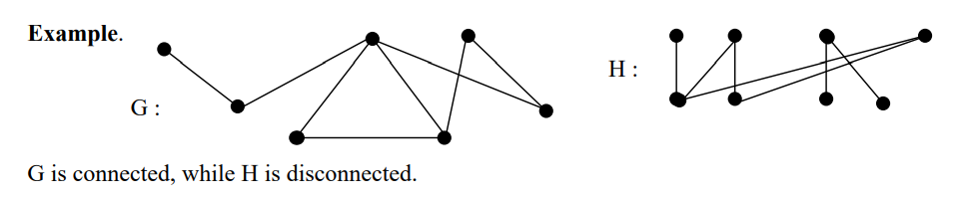
Graph Theory and its Applications Graph Basics
Connected and Disconnected Graph
Connected Graph: path between every pair of vertices exist otherwise it is said to be disconnected.

Slide 32
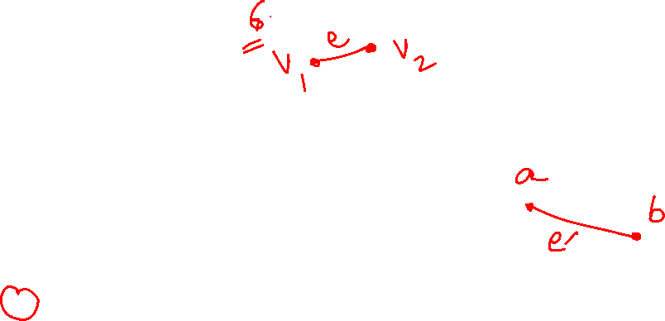
Graph Theory and its Applications Graph Basics
Graph Isomorphism:
Two graphs are equivalent ( or called isomorphic), if they have identical behavior in terms of graph-theoretic properties.
Suppose that edge e is incident on vertices v1 and v2 in G; then the corresponding edge e′ in G′ must be incident on the vertices v′1 and v′2 that correspond to v1 and v2 , respectively.

Slide 33
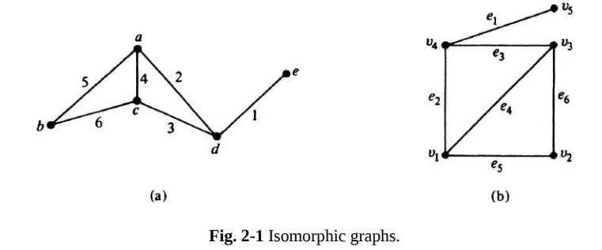

Graph Theory and its Applications Graph Isomorphism:
The vertices a, b, c, d, e correspond to v1 , v2 , v3 , v4 , and v5 , respectively.
The edges 1, 2, 3, 4, 5, and 6 correspond to e1 , e2 , e3 , e4 , e5 , and e6 , respectively

Slide 34



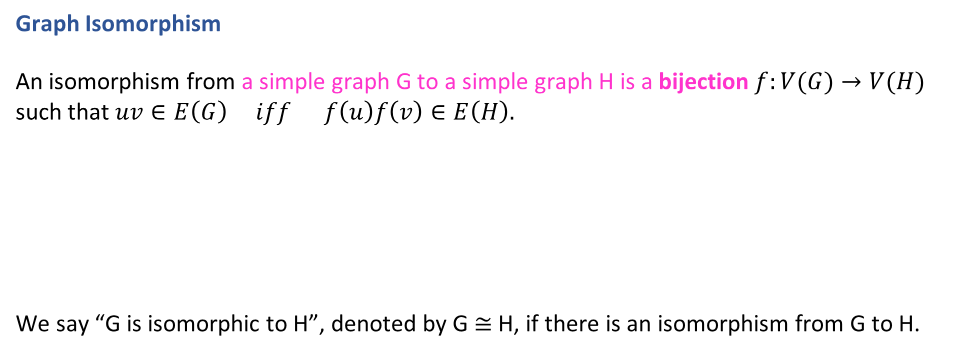
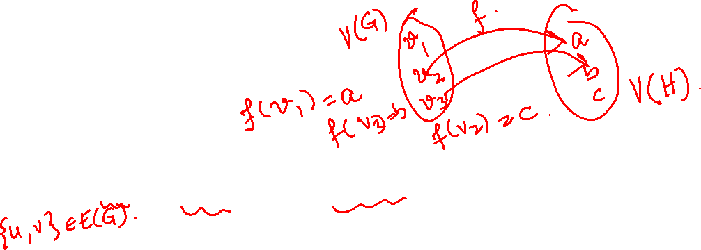
Graph Theory and its Applications Graph Basics
Graph Isomorphism
An isomorphism from a simple graph G to a simple graph H is a bijection $f:V(G)→V(H)$ such that $uv∈E\left(G\right) iff f\left(u\right)f\left(v\right)∈E\left(H\right).$
We say “G is isomorphic to H”, denoted by G ≅ H, if there is an isomorphism from G to H.
G
H

Slide 35
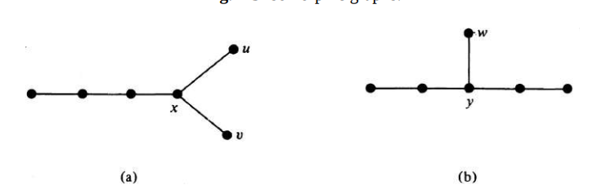
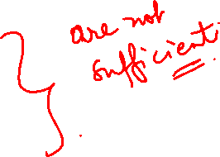
Graph Theory and its Applications Graph Basics
Graph Isomorphism
Two isomorphic graphs must have
The same number of vertices.
The same number of edges.
An equal number of vertices with a given degree.
All 3 conditions are satisfied, yet they are not isomorphic.
If the graph in Fig. (a) were to be isomorphic to the one in (b), vertex x must correspond to y, bcoz there are no other vertices of degree three.
Now in (b) there is only one pendant vertex, w, adjacent to y, while in (a) there are two pendant vertices, u and v, adjacent to x.
However, these conditions are by no means sufficient.

Slide 36

Graph Theory and its Applications
Graph Basics
Regular Graph
A Graph with all vertices having the same degree

Slide 37
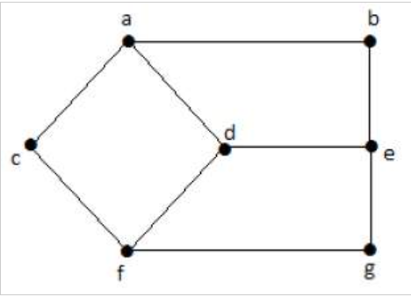
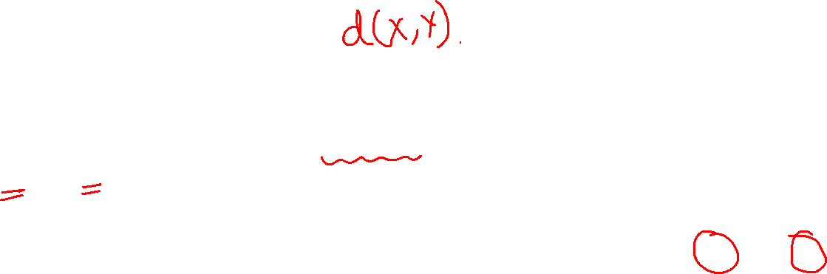
Graph Theory and its Applications Basic Properties of Graph
Basic Properties of Graphs
1. Distance between two Vertices: is shortest path between vertices X and Y denoted by d(X,Y)
Here, the distance from vertex 'd' to vertex 'e' or simply 'de' is 1 as there is one edge between them. There are many paths from vertex 'd' to vertex 'e' −
da, ab, be
df, fg, ge
de (It is considered for distance between the vertices)
df, fc, ca, ab, be
da, ac, cf, fg, ge

Slide 38
Graph Theory and its Applications Basic Properties of Graph
2.Eccentricity of a vertex
Max distance between a vertex and all other vertices denoted by e(V)
In the above graph, the eccentricity of 'a' is 3.
The distance from 'a' to 'b' is 1 ('ab'),
from 'a' to 'c' is 1 ('ac'),
from 'a' to 'd' is 1 ('ad'),
from 'a' to 'e' is 2 ('ab'-'be') or ('ad'-'de'),
from 'a' to 'f' is 2 ('ac'-'cf') or ('ad'-'df'),
from 'a' to 'g' is 3 ('ac'-'cf'-'fg') or ('ad'-'df'-'fg’).
So e(a)=3, which is a maximum from vertex 'a' from the distance between 'ag' which is maximum.
Also, e(b)=3
e(c) = 3
e(d) = 2
e(e) = 3
e(f) = 3
e(g) = 3

Slide 39
Graph Theory and its Applications Basic Properties of Graph
3. Radius of connected graph r(G)
Min eccentricity among all vertices
Radius of Graph G = ?
In the above graph r(G) = 2, which is the minimum eccentricity for 'd'.

Slide 40
Graph Theory and its Applications Basic Properties of Graph
Diameter of connected graph
Max eccentricity among all vertices
Diameter of Graph G = ?
In the above graph, d(G) = 3; which is the maximum eccentricity.

Slide 41
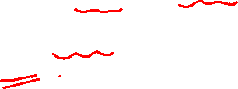
Graph Theory and its Applications Basic Properties of Graphs
Central Point of connected graph
If eccentricity of a vertex = the radius of the graph, then the vertex is known as central point of the graph
Central Point of Graph G= d as e(d)=2 and r(G)= 2
Centre of connected graph
The set of all central points of the graph is known as the centre of the graph.
S={d}

Slide 42
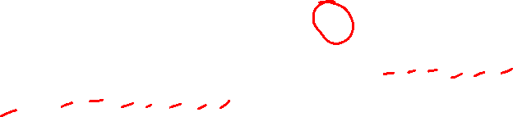
Graph Theory and its Applications Basic Properties of Graph
7. Circumference of connected graph
The total # of edges in the longest cycle
of Graph G is known as the circumference of G
The circumference of G is 6, which we derived from the longest cycle a-c-f-g-e-b-a or a-c-f-d-e-b-a.

Slide 43
Graph Theory and its Applications Basic Properties of Graph
8. Girth of connected graph
The total # of edges in the shortest cycle
of Graph G is known as the girth of G
Girth of Graph G is ?
4

Slide 44
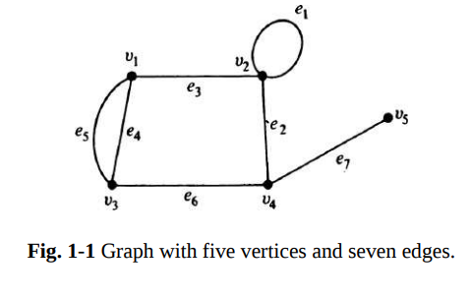
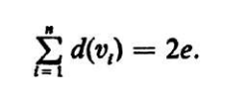
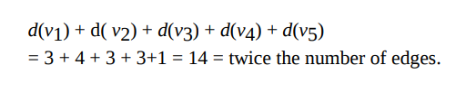
Graph Theory and its Applications Graph Basics
When a vertex v_{i} is an end vertex of some edge e_{j}, v_{i} and e_{j} are said to be incident with each other. In Graph G ‘ e₃ ‘ is incident on v1and v2.
Consider a graph G with e edges and n vertices. Since each edge contributes 2 degrees,
the sum of the degrees of all vertices in G = 2 (the # of edges in G)

Slide 45
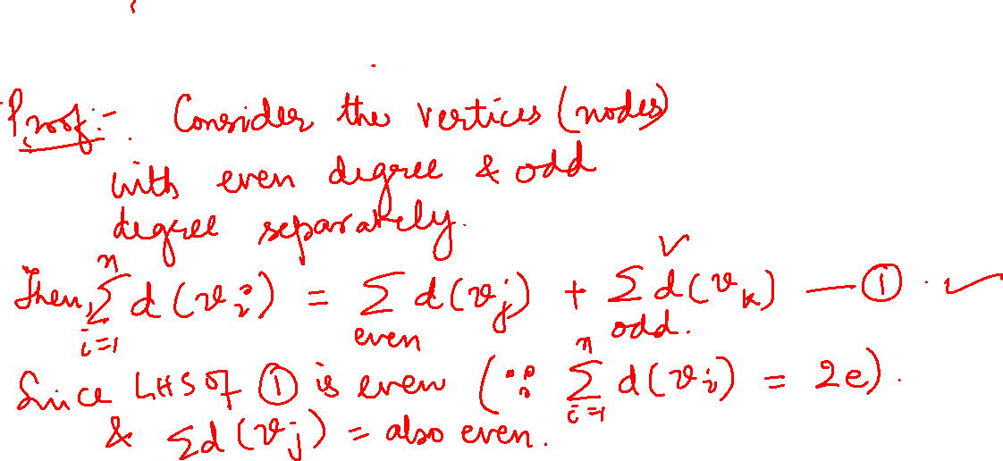
Graph Theory and its Applications
Graph Basics
THEOREM 1-1
The number of vertices of odd degree in a graph is always even.

Slide 46
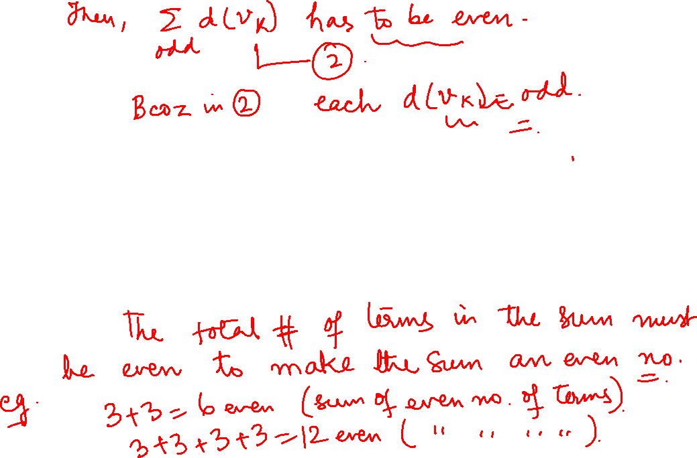
THANK YOU
Dr. Arti Arya
Department of Computer Science &Engineering
artiarya@pes.edu

